Slide 1

Review of Fundamentals of DSP

Slide 2
Contents
Discrete-Time Signals and Systems
Transform Representation of Signals and Systems
Fundamentals of Digital Filters
Sampling and Summary

Slide 3
Discrete-Time Signals and Systems

Slide 4
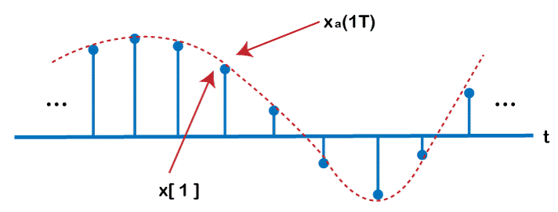
Discrete-Time Signals and Systems
Introduction to Discrete-Time Signals
Definition of Signals:
Explanation of discrete-time signals in digital signal processing.
Types of Discrete-Time Signals:
Unit impulse, unit step, exponential, sinusoidal, and random signals.

Slide 5
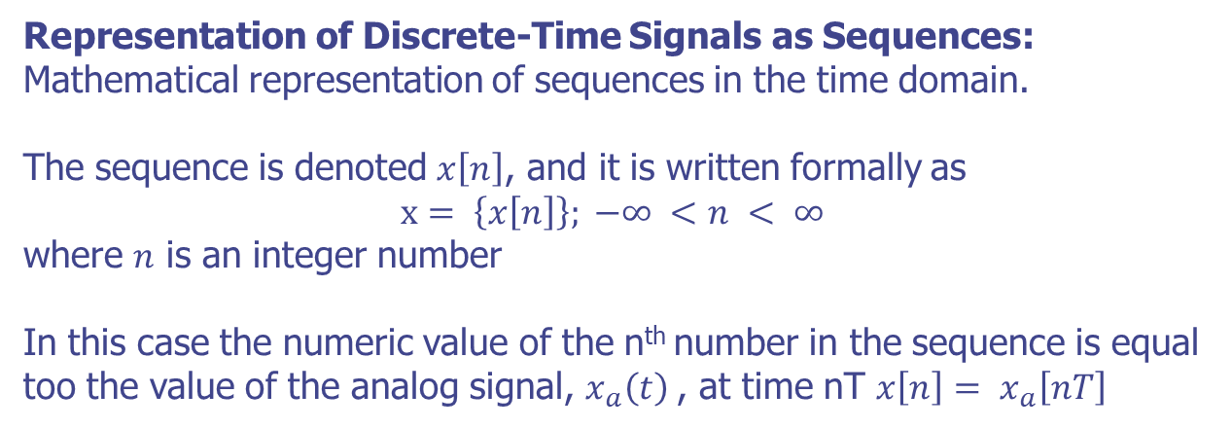
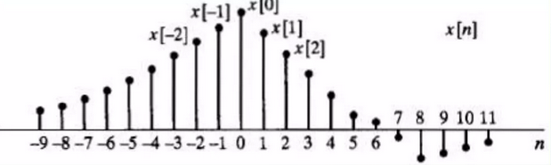
Discrete-Time Signals and Systems
Signal Sequences

Slide 6
Discrete-Time Signals and Systems
Classification of Systems
Classification Based on Properties:
Linearity, time-invariance, causality, and stability.
Types of Systems:
Difference equations, convolutional systems, and finite impulse response (FIR) systems.

Slide 7
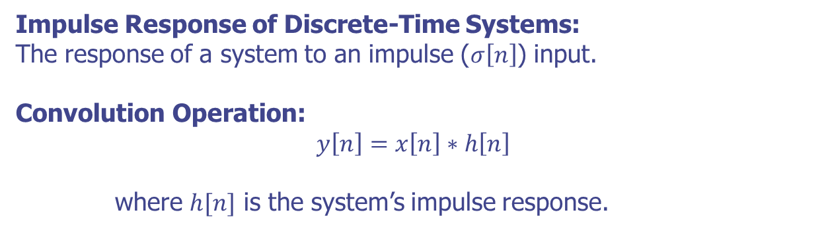
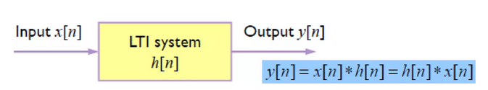
Discrete-Time Signals and Systems
Impulse Response and Convolution

Slide 8
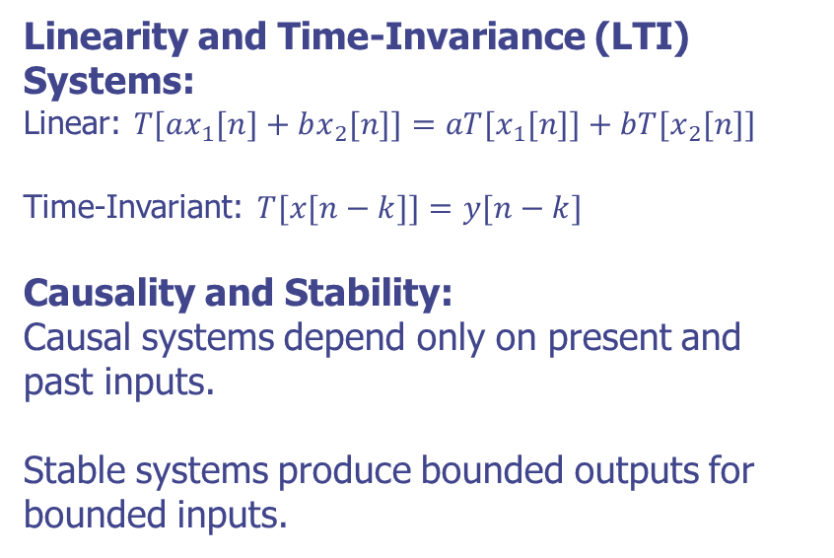
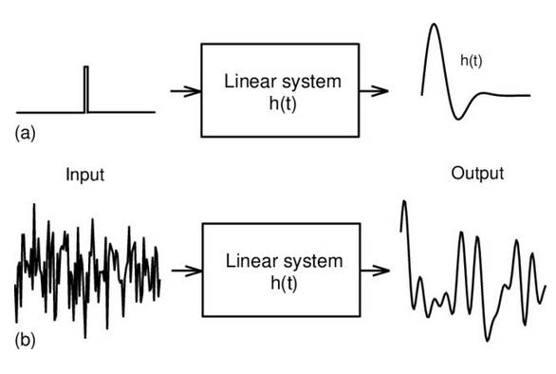
Discrete-Time Signals and Systems
System Properties

Slide 9
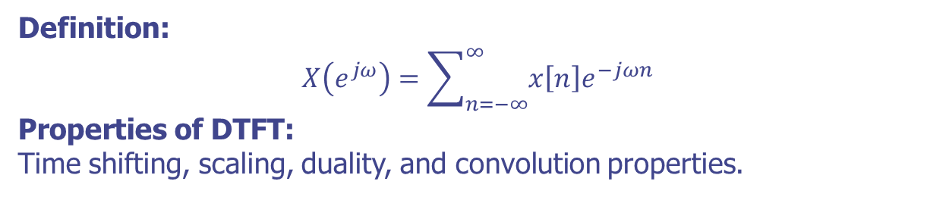
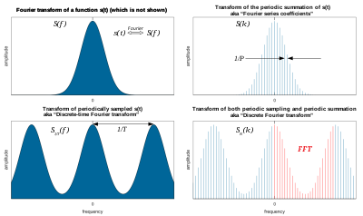
Discrete-Time Signals and Systems
Discrete-Time Fourier Transform (DTFT)

Slide 10
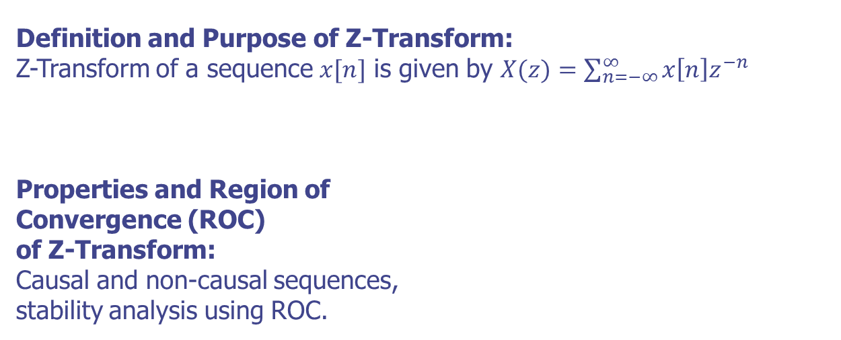
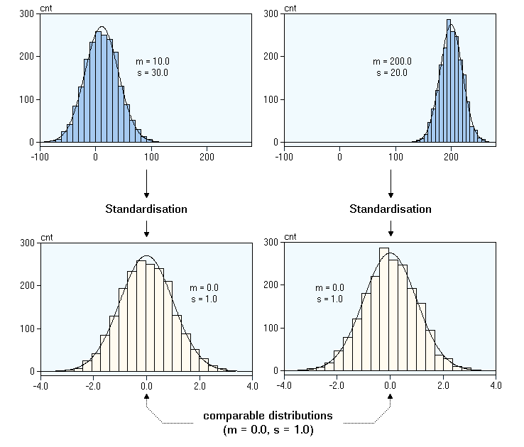
Discrete-Time Signals and Systems
Z-Transform

Slide 11
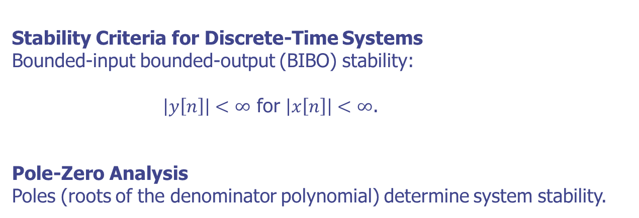
Discrete-Time Signals and Systems
Analysis of Stability

Slide 12
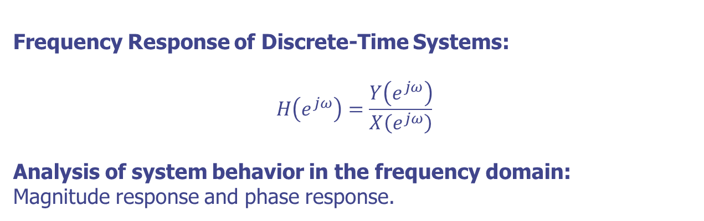
Discrete-Time Signals and Systems
Frequency Response Analysis

Slide 13
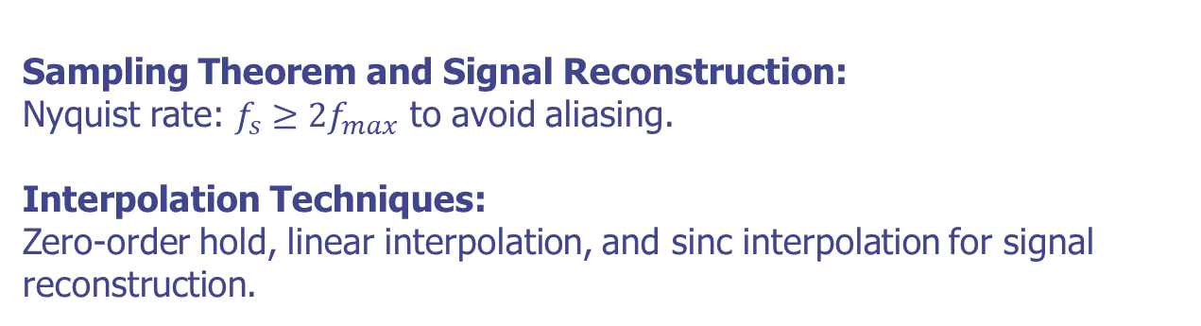
Discrete-Time Signals and Systems
Sampling and Reconstruction

Slide 14
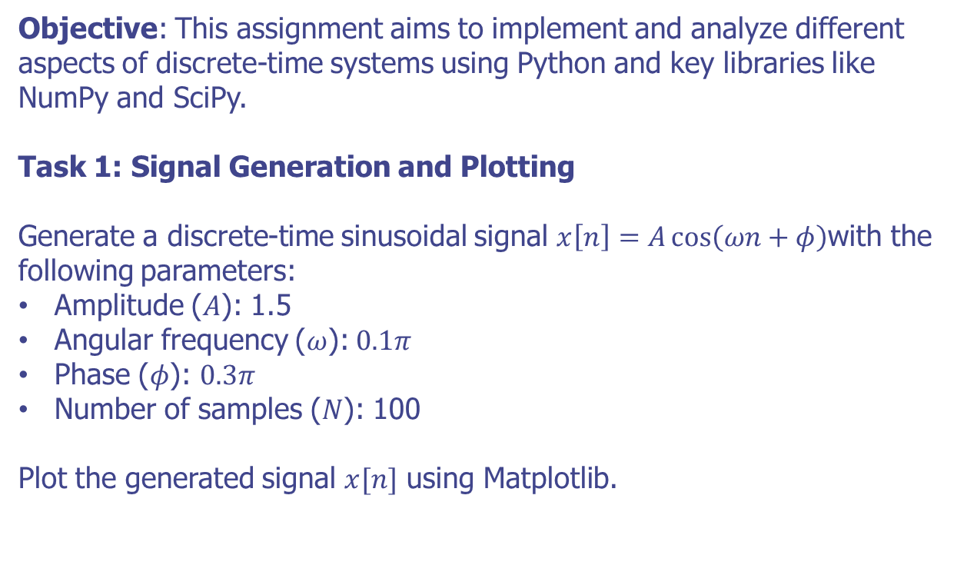
Discrete-Time Signals and Systems
Practical Implementation Assignment

Slide 15
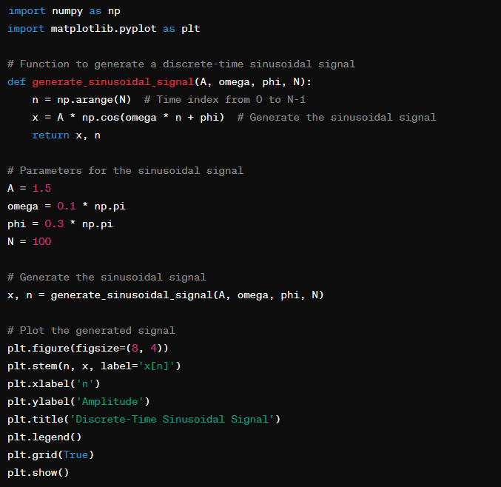
Discrete-Time Signals and Systems
Practical Implementation Assignment
Task 1: Signal Generation and Plotting - Solution

Slide 16
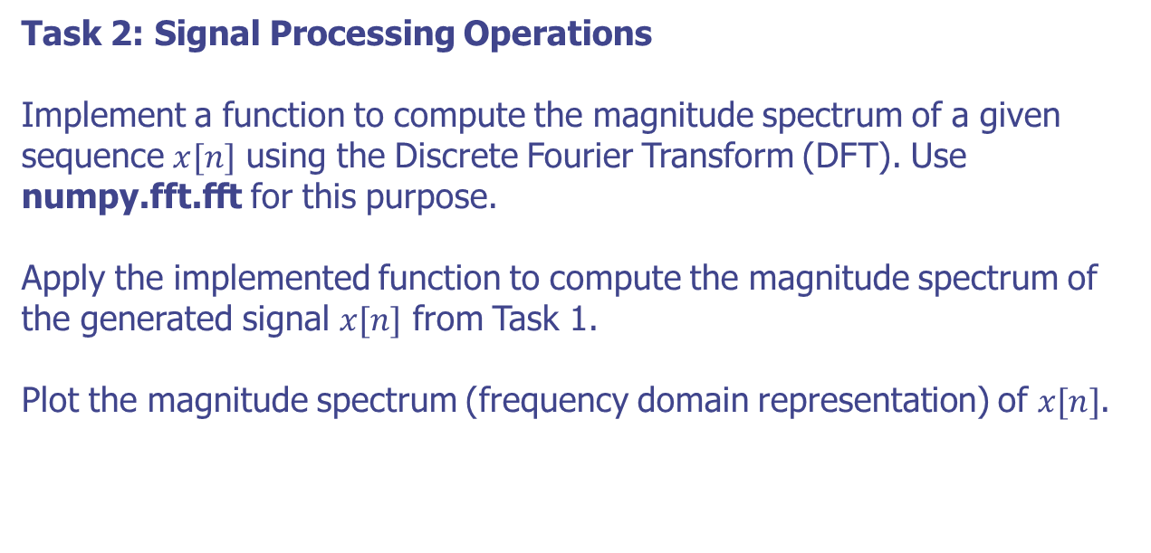
Discrete-Time Signals and Systems
Practical Implementation Assignment

Slide 17
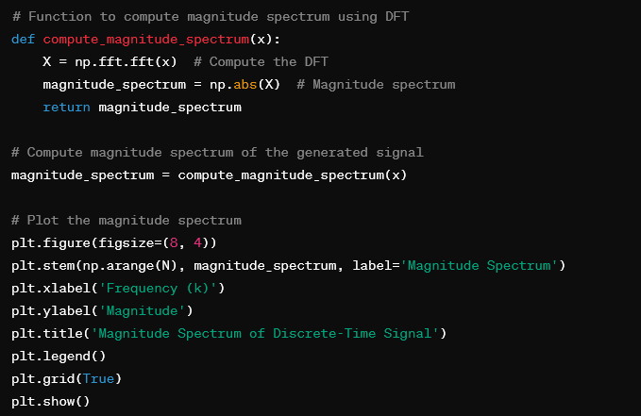
Discrete-Time Signals and Systems
Practical Implementation Assignment
Task 2: Signal Processing Operations - Solution

Slide 18
Transform Representation of Signals and Systems

Slide 19
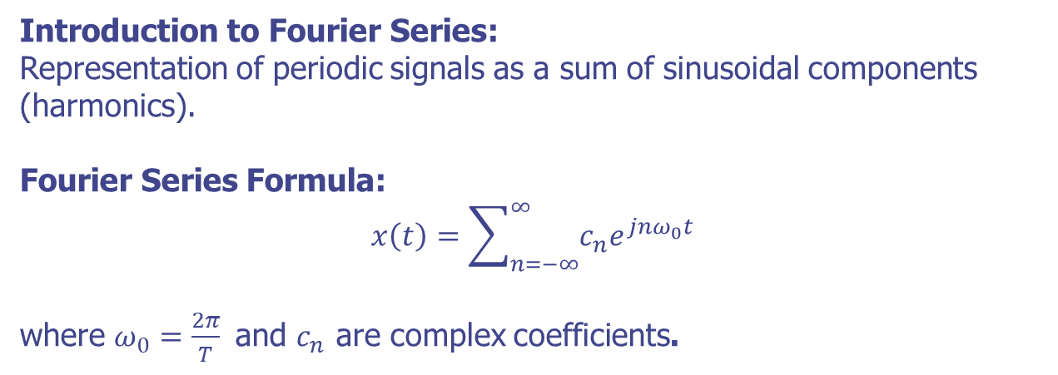
Transform Representation of Signals and Systems
Fourier Series (Continuous-Time)

Slide 20
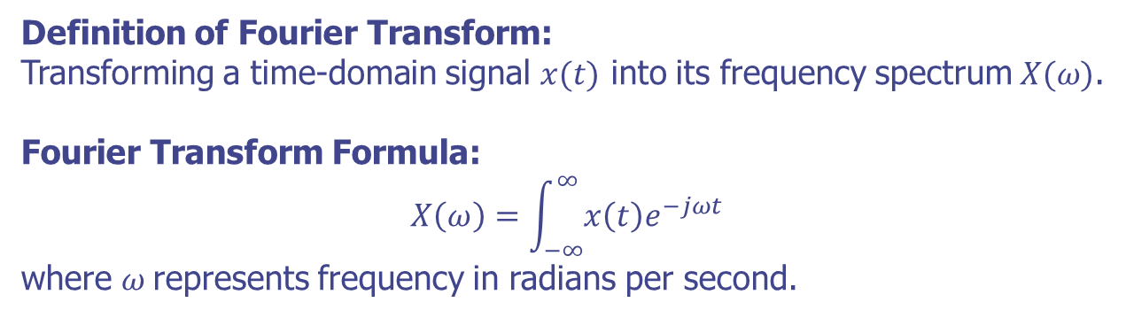
Transform Representation of Signals and Systems
Fourier Transform (Continuous-Time)

Slide 21
Transform Representation of Signals and Systems
Properties of Fourier Transform
Key Properties:
Linearity, Time Shifting, Time Scaling, Convolution Theorem.
Illustrative Examples:
Demonstrations using mathematical expressions and graphical representations of transformed signals.

Slide 22
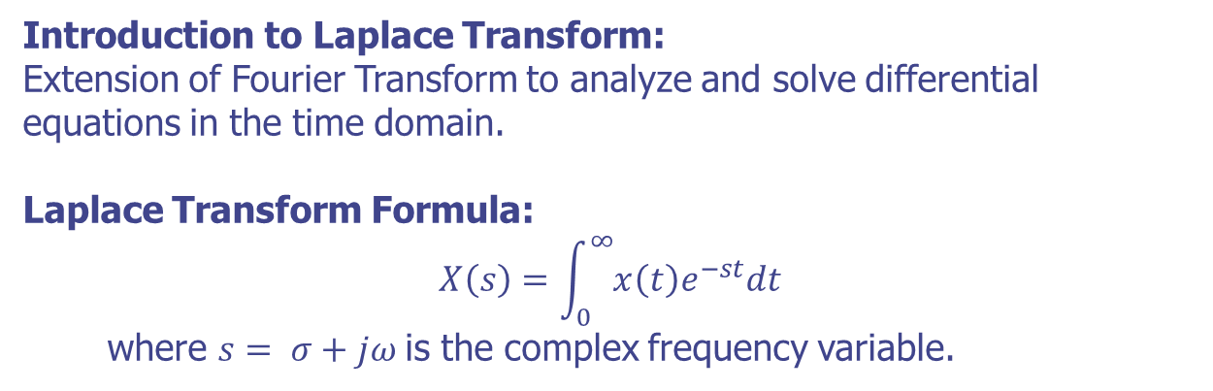
Transform Representation of Signals and Systems
Laplace Transform

Slide 23
Transform Representation of Signals and Systems
Laplace Transform Properties
Properties and Concepts:
Region of Convergence (ROC), Linearity, Time Shifting, Time Scaling.
Importance in System Analysis:
Transfer functions, system stability, response analysis.

Slide 24
Transform Representation of Signals and Systems
Relationship between Transforms
Connections and Relationships:
Linking Fourier Transform, Laplace Transform, and Z-Transform.
Unified Perspective:
How transforms provide a unified signal and system analysis framework across continuous-time and discrete-time domains.

Slide 25
Fundamentals of Digital Filters

Slide 26
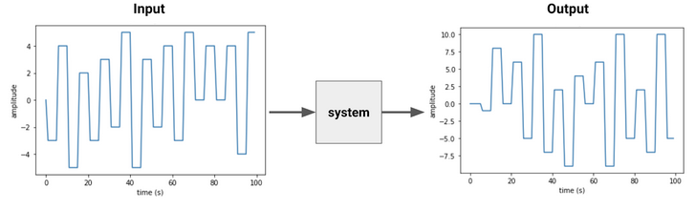
Fundamentals of Digital Filters
Introduction
Definition of Digital Filters
Filters that operate on digital signals to modify or enhance specific frequency components.
Importance of Digital Filters
Signal conditioning, noise reduction, and signal enhancement in various applications.

Slide 27
Fundamentals of Digital Filters
Classification
FIR (Finite Impulse Response) Filters:
Characteristics:
Have a finite duration impulse response.
Provide linear phase response, making them suitable for applications requiring phase linearity.
Applications in Speech Processing: Ideal for implementing linear-phase filters for applications like signal equalization and echo cancellation.
IIR (Infinite Impulse Response) Filters:
Characteristics:
Include feedback in their structure, resulting in potentially infinite-duration impulse response.
Generally more computationally efficient compared to FIR filters.
Applications in Speech Processing: Used for applications requiring efficient real-time processing, such as voice communication systems.

Slide 28
Fundamentals of Digital Filters
FIR Filters
Structure of FIR Filters
Represented by a feedforward structure without feedback loops.
Each output sample is computed as a weighted sum of input samples.
Advantages in Speech Processing
Linear phase response preserves the phase information of speech signals, which is crucial for maintaining signal integrity in filtering applications.

Slide 29
Fundamentals of Digital Filters
Design Methods for FIR Filters
Windowing Techniques
Hamming, Blackman, and Kaiser windows are used to design low-pass, high-pass, or band-pass FIR filters.
Frequency Sampling Method
Directly specify the desired frequency response at specific points and interpolate between them to obtain filter coefficients.
Parks-McClellan Algorithm (Remez Exchange Algorithm)
Optimal design method for FIR filters that minimizes the maximum error between the desired and actual frequency responses.

Slide 30
Fundamentals of Digital Filters
IIR Filters
Structure of IIR Filters
Incorporate feedback loops in addition to feedforward components.
The recursive nature allows for more compact filter designs.
Advantages in Speech Processing
More computationally efficient compared to FIR filters for achieving similar frequency responses..

Slide 31
Fundamentals of Digital Filters
Design Methods for IIR Filters
Butterworth, Chebyshev, and Elliptic (Cauer) Filter Designs:
Specify filter characteristics such as passband ripple, stopband attenuation, and transition width to design IIR filters with specific performance requirements.
Impulse Invariant Method and Bilinear Transformation
Techniques for transforming analog filter designs into digital IIR filters while preserving critical characteristics like stability and frequency response.

Slide 32
Sampling and Summary

Slide 33
Sampling and Summary
Introduction
Definition
Sampling is the process of converting a continuous-time speech signal into a discrete-time signal by extracting samples at regular intervals..
Sampling Theorem (Nyquist-Shannon Theorem)
States that to accurately reconstruct a continuous signal from its samples, the sampling rate must be at least twice the highest frequency component in the signal (Nyquist rate).

Slide 34
Sampling and Summary
Sampling Rate and Nyquist Frequency
Definition
Determined by the number of samples taken per second (measured in Hz or samples per second, sps).
Common sampling rates for speech processing: 8 kHz (telephony), 16 kHz (voice communication), 44.1 kHz (CD audio quality).
Sampling Theorem (Nyquist-Shannon Theorem)
Half of the sampling rate (Fs/2), which defines the maximum frequency that can be accurately represented without aliasing.

Slide 35
Sampling and Summary
Aliasing and Anti-Aliasing Filters
Aliasing
Occurs when high-frequency components in the speech signal fold back into lower frequencies due to insufficient sampling rate.
Anti-Aliasing Filters
Used to remove high-frequency components (above the Nyquist frequency) prior to sampling to prevent aliasing.
Commonly implemented as low-pass filters.

Slide 36
Summary
Discrete-Time Signals and Systems:
Basics of discrete-time signals and systems.
Analysis of system behavior through input-output relationships.
Transform Representation of Signals and Systems:
Use transforms (e.g., Fourier, Z-transform) to represent signals and systems.
Importance of frequency domain analysis for understanding signal properties.
Fundamentals of Digital Filters:
Introduction to digital filters, including FIR and IIR types.
Design and implementation principles for filtering digital signals.

Slide 37
Q & A

